Slide 1
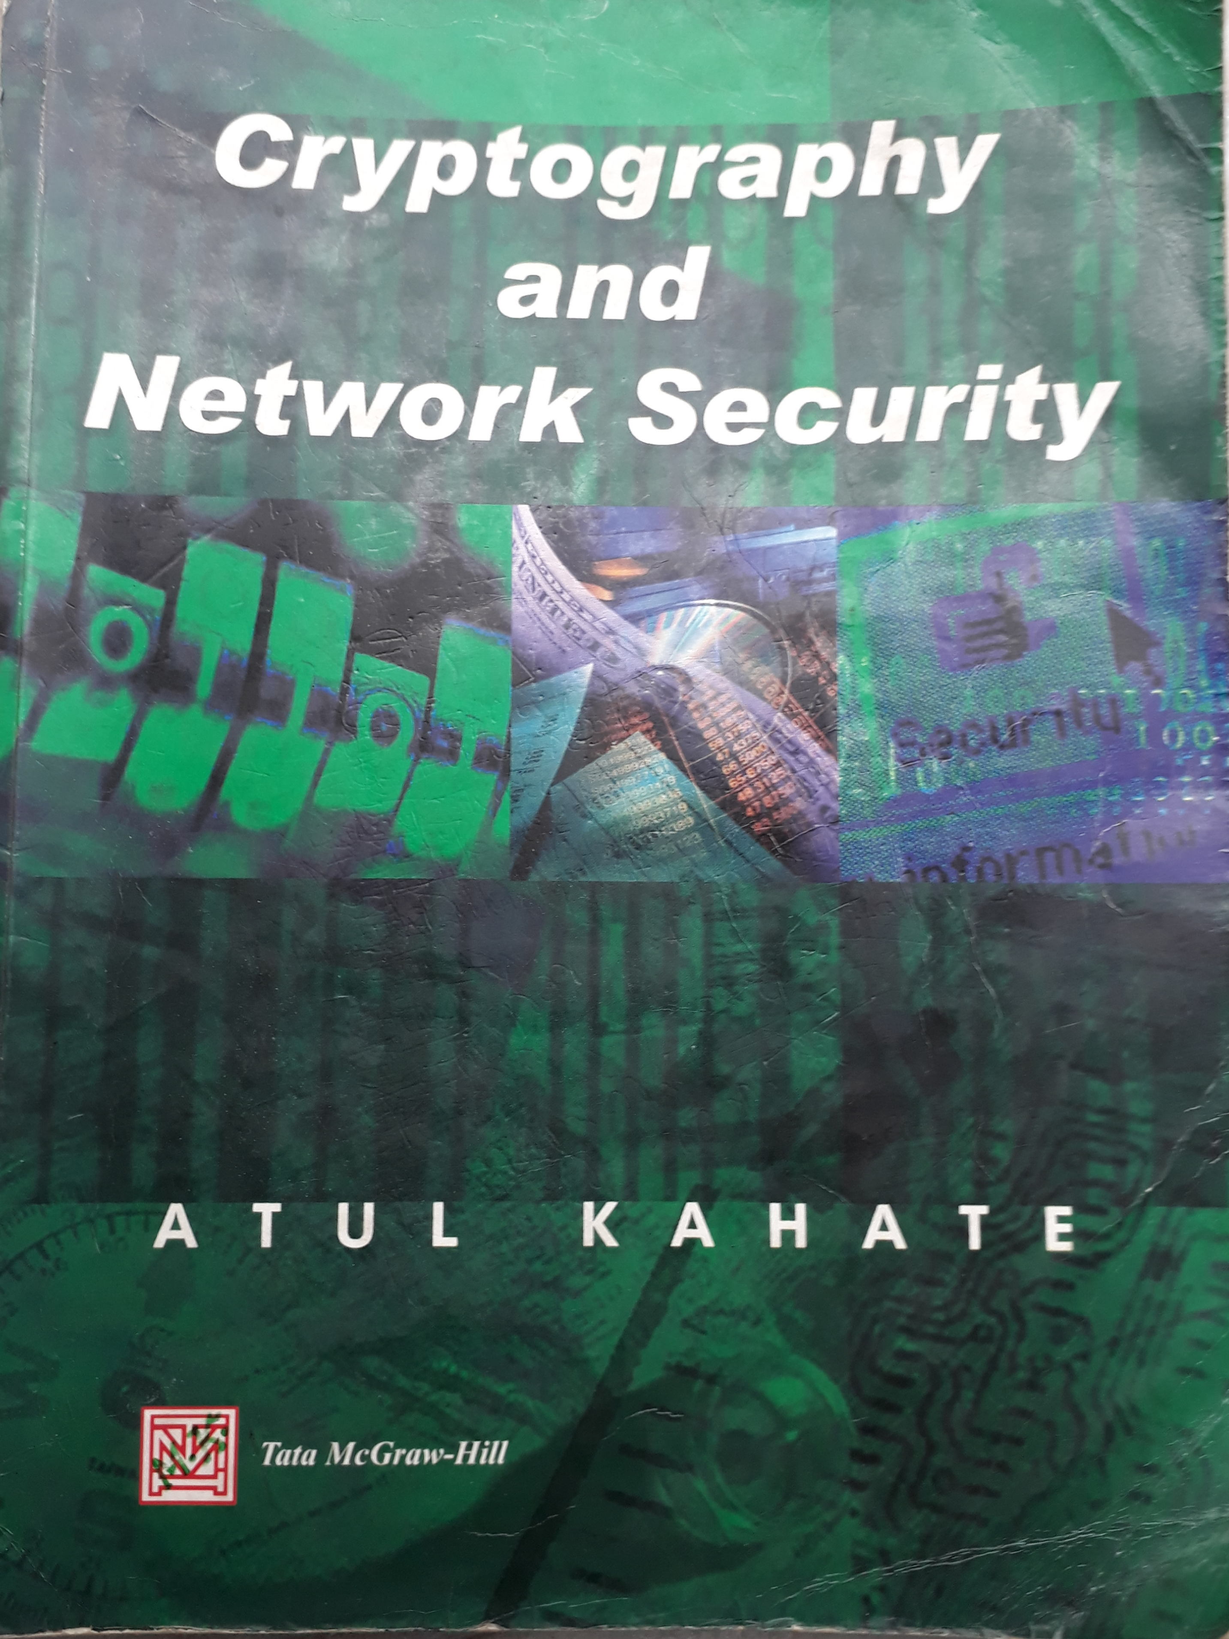
Books (1/2)

Slide 2

Books (2/2)

Slide 3
Information Security
“Three people can keep a secret only if two of them are dead”
----- Benjamin Franklin

Slide 4
Security Models
No security
Security through obscurity: keeping the inner workings of a system or software hidden
Host security: securing individual devices or systems. Ex: Access control, Application whitelisting, Anti-malware software, Data encryption
Network security: secures the network infrastructure used to connect devices and systems. Ex: Firewalls, Intrusion Detection/Prevention System (IDS/IPS)

Slide 5
Principles of Security
Confidentiality
Authentication
Integrity
Non-repudiation
Access control
Availability

Slide 6
Confidentiality: (Interception)
Definition: Ensuring that information is only accessible to authorized individuals or systems.
Objective: Preventing unauthorized disclosure of sensitive data.
Authentication: (Fabrication)
Definition: Verifying the identity of users or systems to ensure they are who they claim to be.
Objective: Preventing unauthorized access by confirming the legitimacy of entities.
Integrity:
Definition: Ensuring that data remains accurate, unaltered, and trustworthy throughout its lifecycle.
Objective: Protecting against unauthorized modifications or corruption of information.
Non-repudiation:
Definition: Ensuring that individuals or entities cannot deny their actions or transactions.
Objective: Providing proof of the origin or delivery of a message or the authenticity of a transaction.
Access Control:
Definition: Managing permissions to restrict access to resources based on the identity and privileges of users.
Objective: Limiting unauthorized access to sensitive information or critical systems.
Availability: (Interruption)
Definition: Ensuring that systems and resources are accessible and operational when needed.
Objective: Minimizing downtime and disruptions to maintain a consistent level of service.

Slide 7
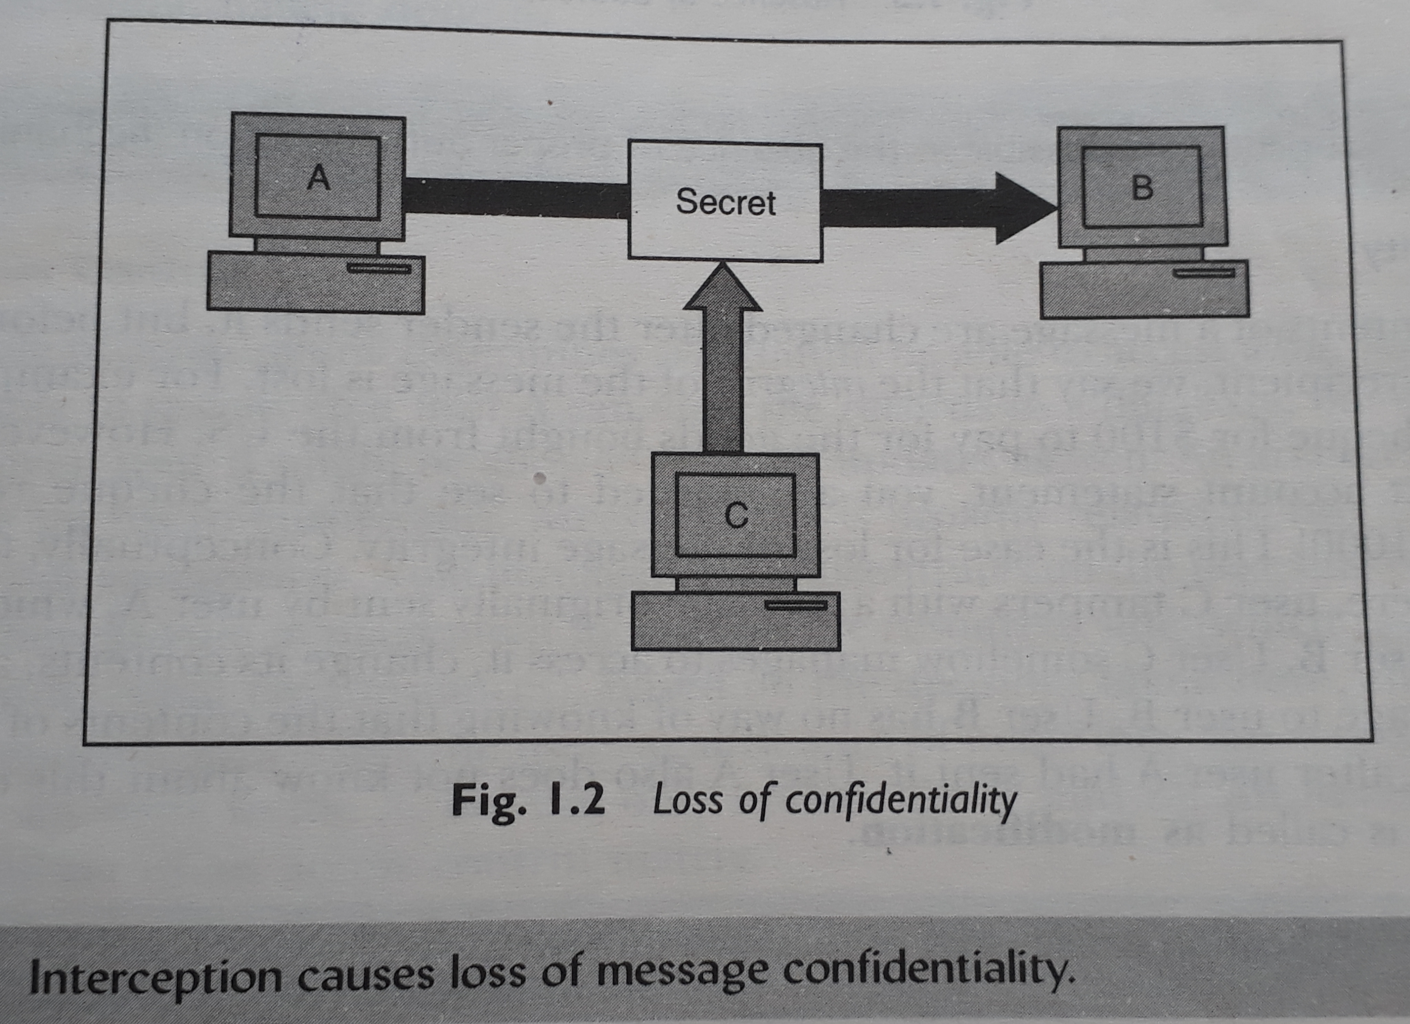
Confidentiality
1 :

Slide 8
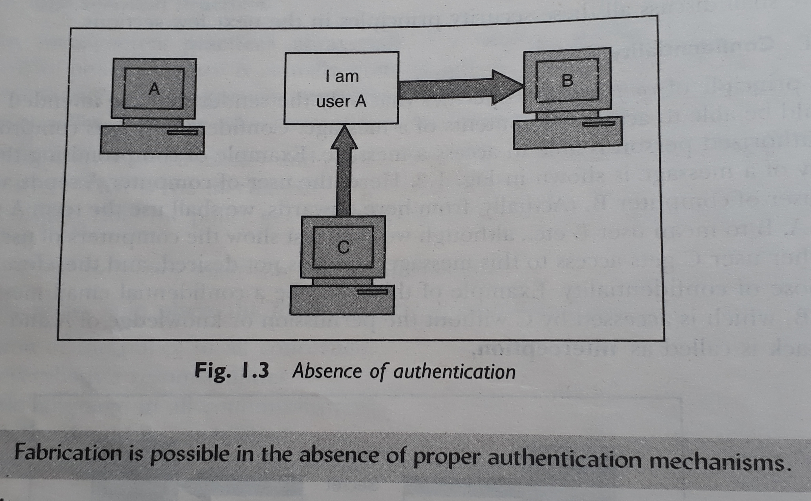
Authentication
2 :

Slide 9
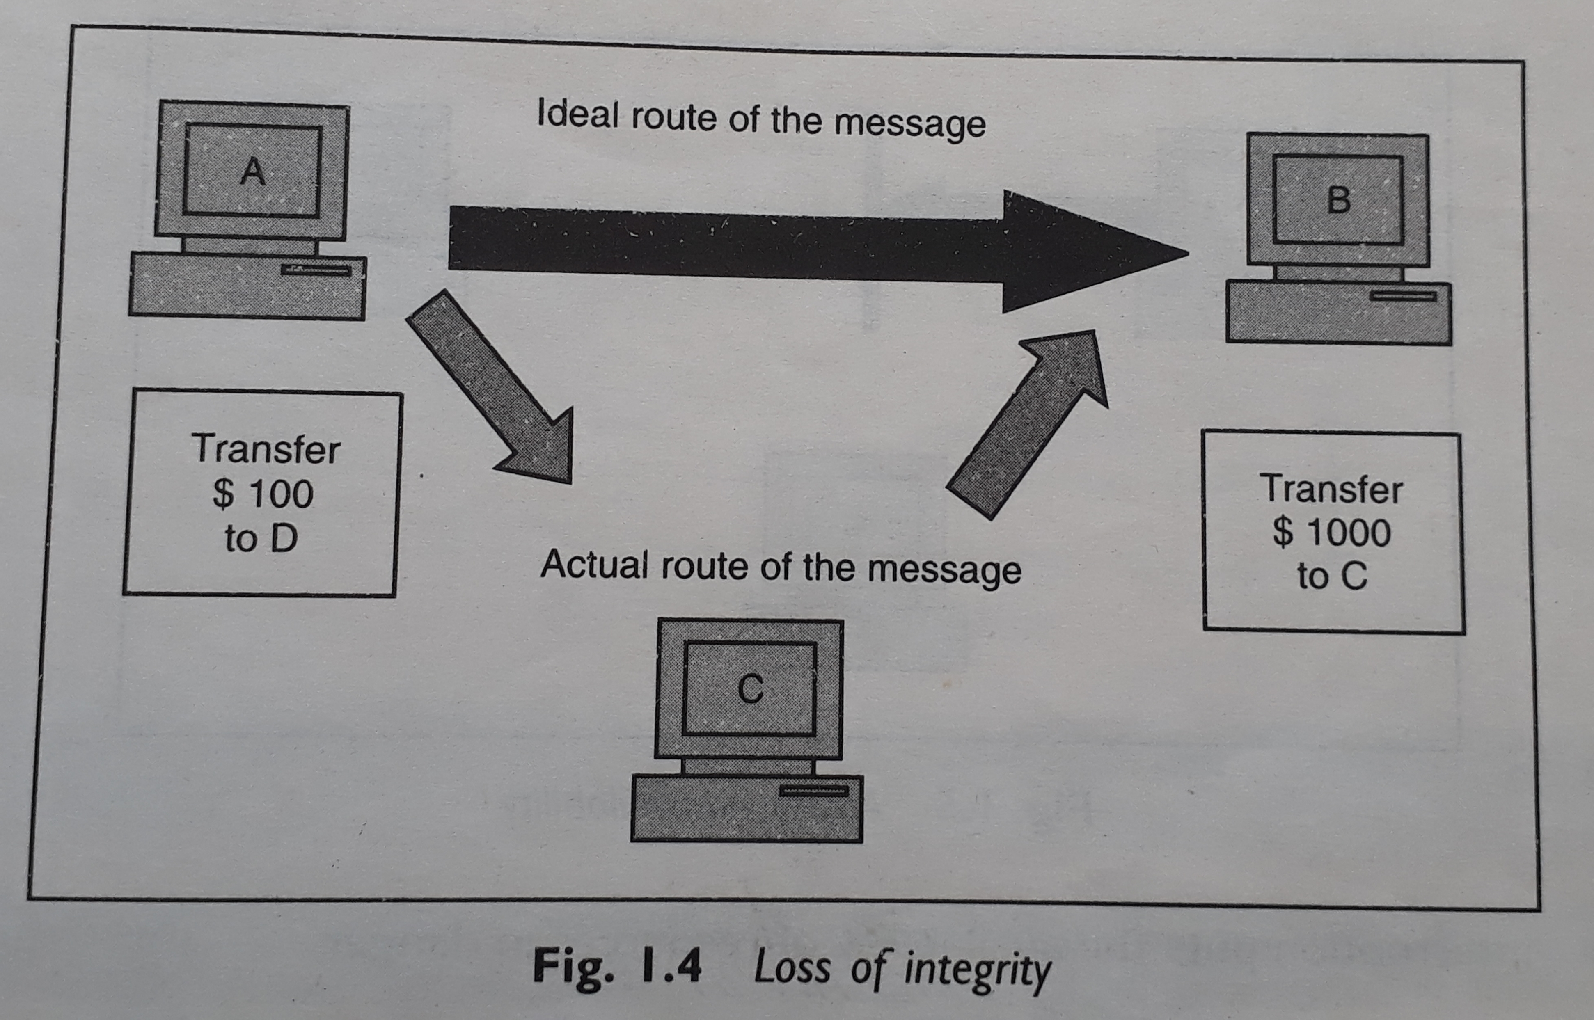
Integrity
3 :

Slide 10
Non-repudiation
Non-repudiation does not allow the sender of a message to refute the claim of not sending that message.
Digital Signature can be used to maintain this principle of security.

Slide 11
Access Control
Access control specifies and controls who can access what.
Access control is broadly related to two areas:
a) Role Management – which user can do what.
b) Rule Management – which resource is accessible and under what circumstances.

Slide 12
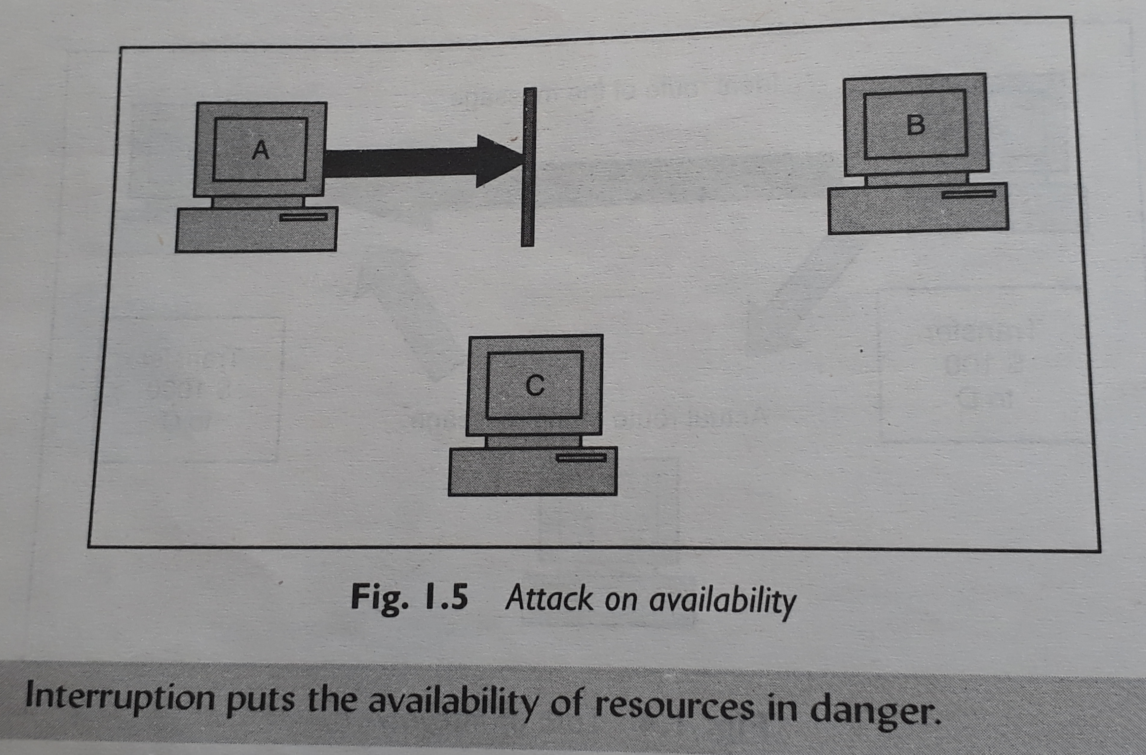
Availability
4 :

Slide 13
Types of Attack
Broad Categories
Theoretical concepts behind the attacks
Practical approaches used by the attackers

Slide 14
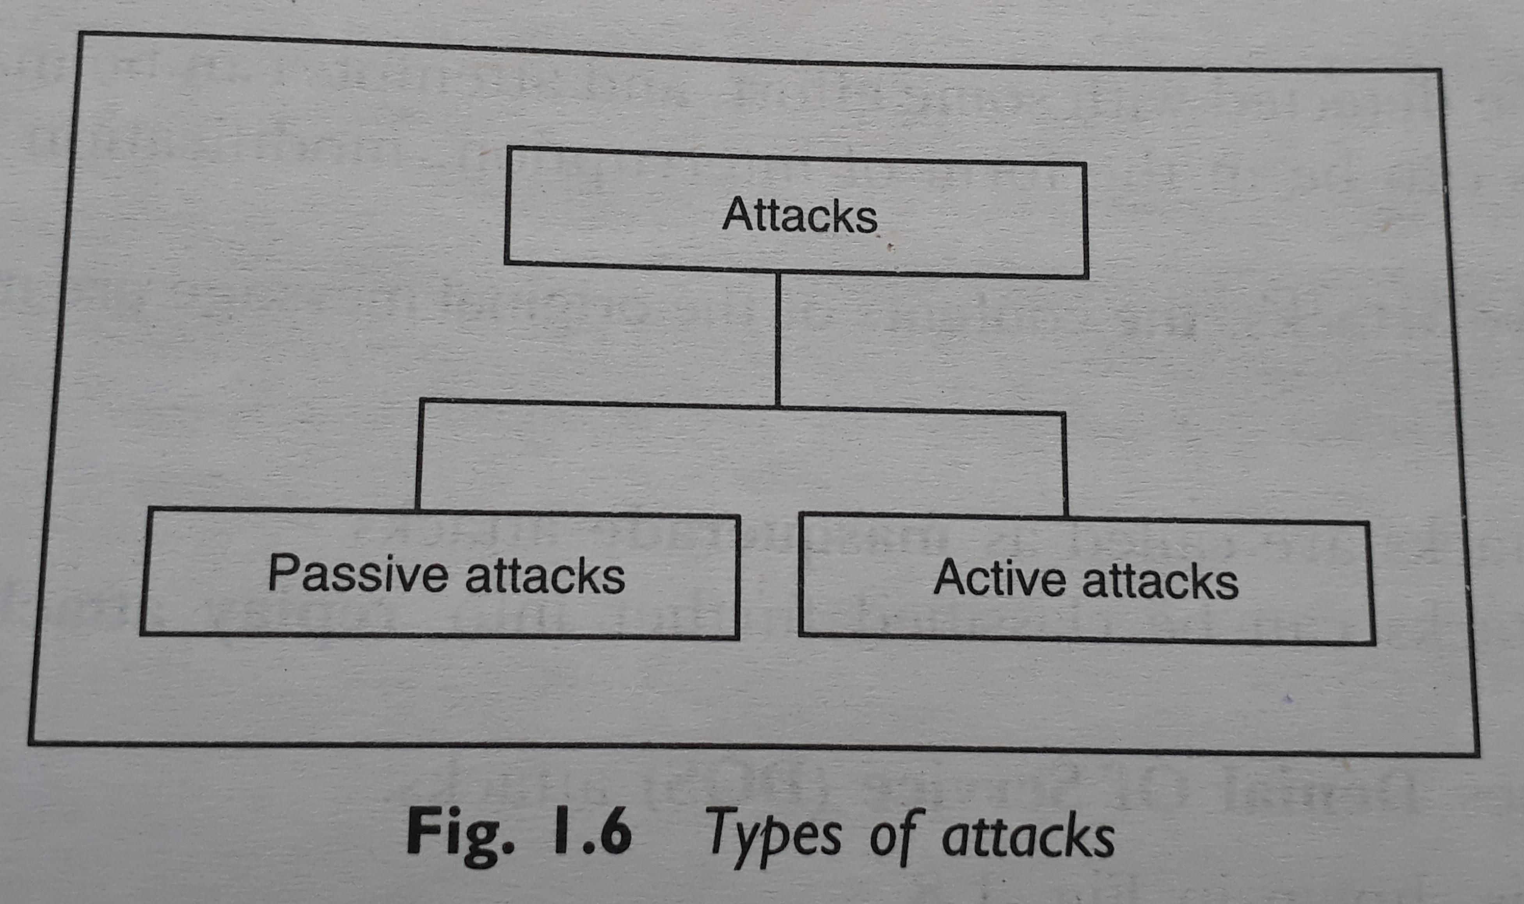
Theoretical Concepts
5 :

Slide 15
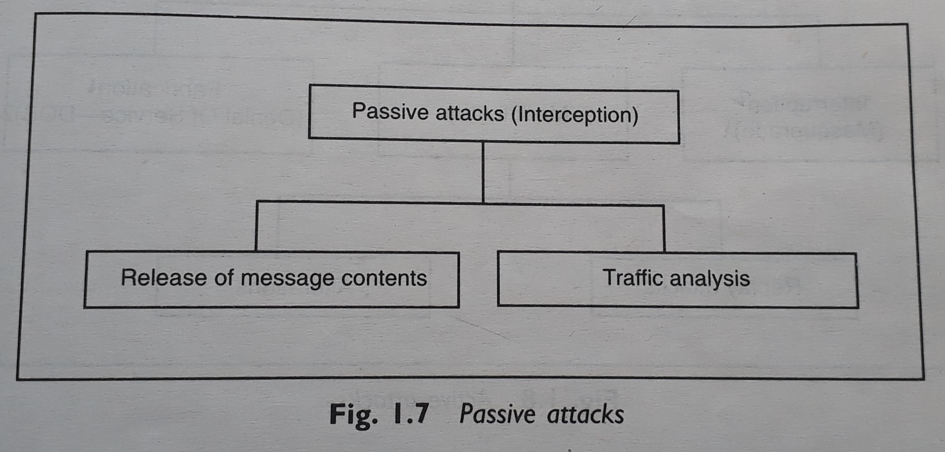
Passive Attacks
6 :

Slide 16
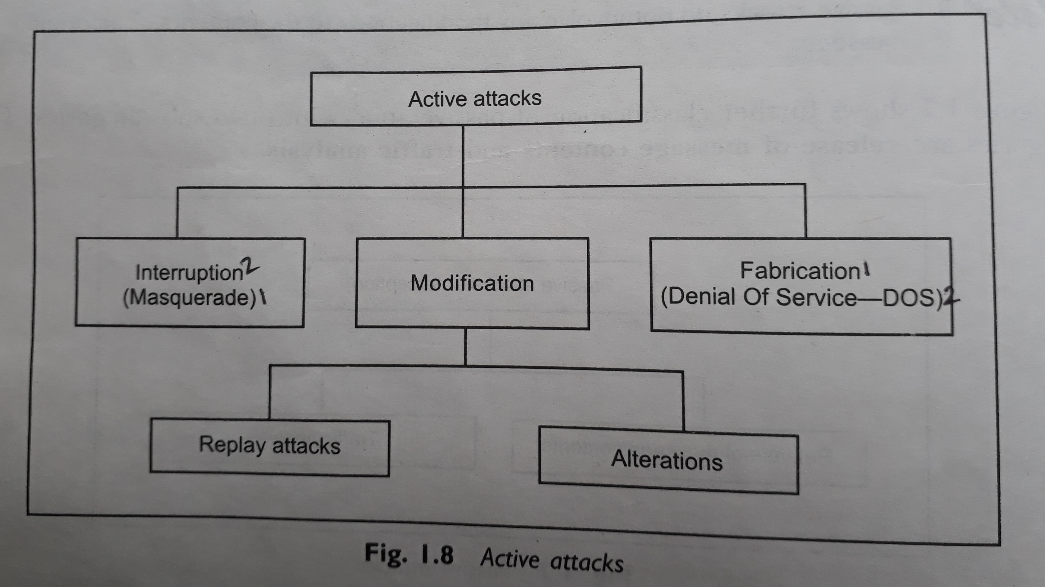
Active Attacks
7 :

Slide 17
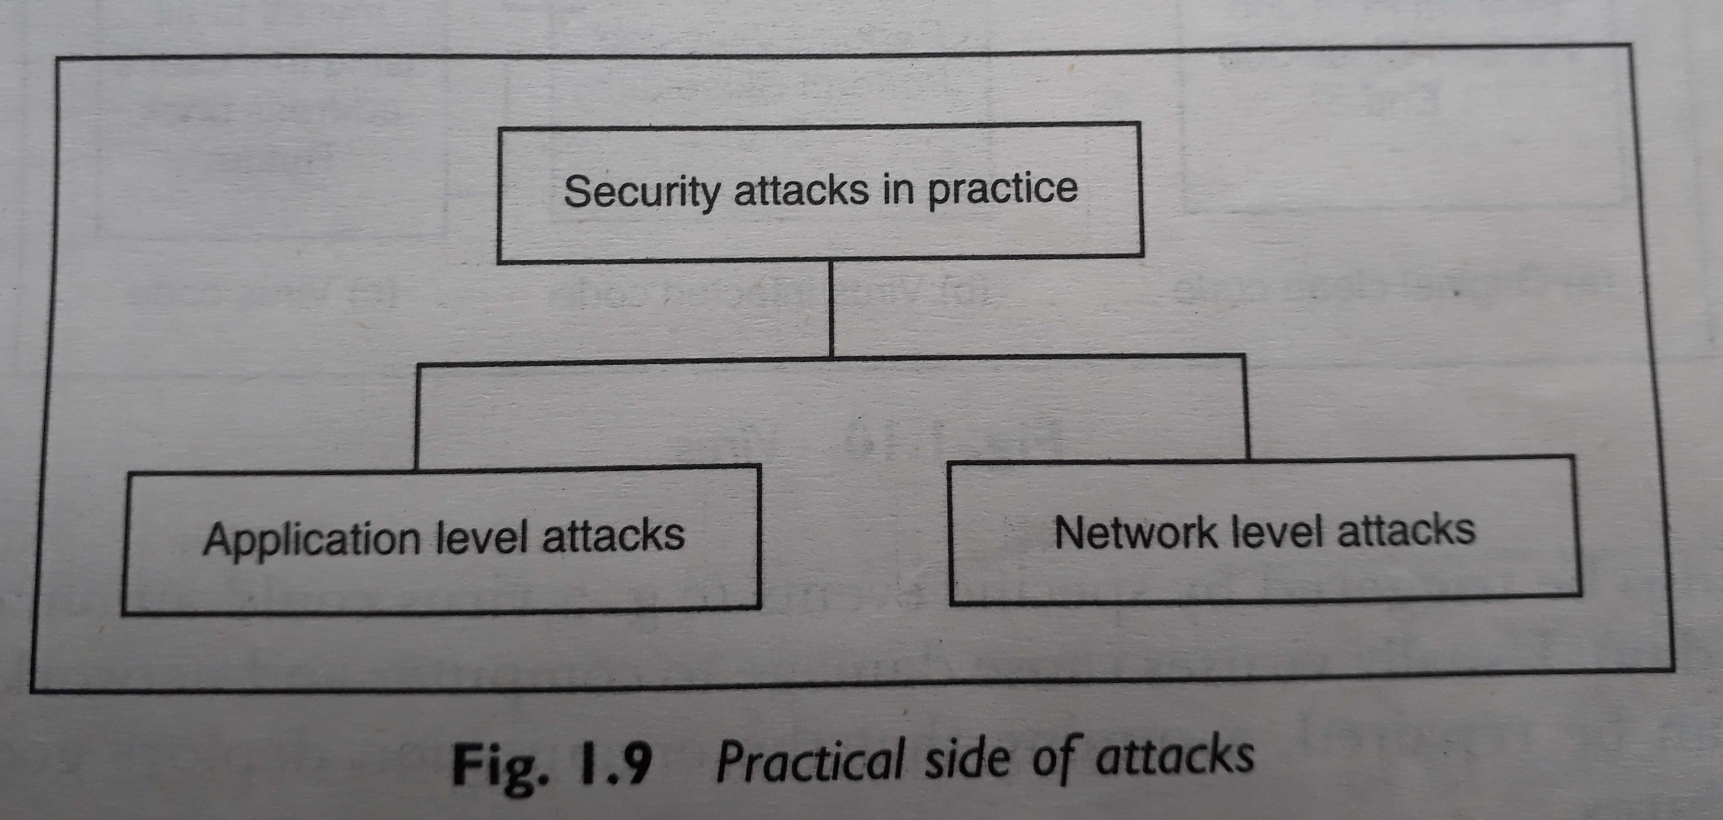
The Practical Side of Attacks
8 :

Slide 18
Specific Attacks
Packet Sniffing (Snooping) / IP Sniffing : IP sniffing, or packet sniffing, is the practice of intercepting and examining data packets flowing over a network.
Packet Spoofing / IP Spoofing : IP spoofing involves manipulating the source address in the header of an IP packet to deceive the recipient about the origin of the message.

Slide 19
Next Topic
Basic Cryptographic Techniques
a) Substitution Techniques
b) Transposition techniques

Slide 20
a) Substitution Techniques:
Definition: Substitution techniques involve replacing elements (usually letters or characters) in the plaintext with other elements based on a specific algorithm or key.
Example: Caesar Cipher is a basic substitution technique where each letter in the plaintext is shifted by a fixed number of positions in the alphabet.
Advantages: Simple to understand and implement, but vulnerable to frequency analysis and brute-force attacks.
Weaknesses: Prone to pattern recognition and may not provide strong security for sensitive information.
b) Transposition Techniques:
Definition: Transposition techniques involve rearranging the order of characters in the plaintext without altering the actual characters themselves.
Example: Rail Fence Cipher is a basic transposition technique where characters are written in a zigzag pattern and then read out to create the ciphertext.
Advantages: Provides a level of complexity and can be more resistant to frequency analysis compared to substitution techniques.
Weaknesses: Still susceptible to certain types of attacks, such as known-plaintext attacks, and may require additional layers of security for robust encryption.

Slide 21
Thank You

Slide 22
Questions?

